Slide 1

Note: The data and information in this document is reflective of a hypothetical situation and client. This document is to be used for KPMG Virtual Internship purposes only.
Sprocket Central Pty Ltd
Data analytics approach
[Division Name] - [Engagement Manager], [Senior Consultant], [Junior Consultant]

Slide 2
Note: The data and information in this document is reflective of a hypothetical situation and client. This document is to be used for KPMG Virtual Internship purposes only.
Agenda
Introduction
Data Exploration
Model Development
Marketing Strategy

Slide 3

Note: The data and information in this document is reflective of a hypothetical situation and client. This document is to be used for KPMG Virtual Internship purposes only.
Introduction
Business Objective:
Sprocket Central Pty Ltd aims to locate the next target customers group in new customer list.
Setting marketing strategy.
Our Solutions:
Use RFM Model to analyze old customers.
Use K Means Algorism to segment potential customers.
Build marketing strategies based on customer
insights.

Slide 4
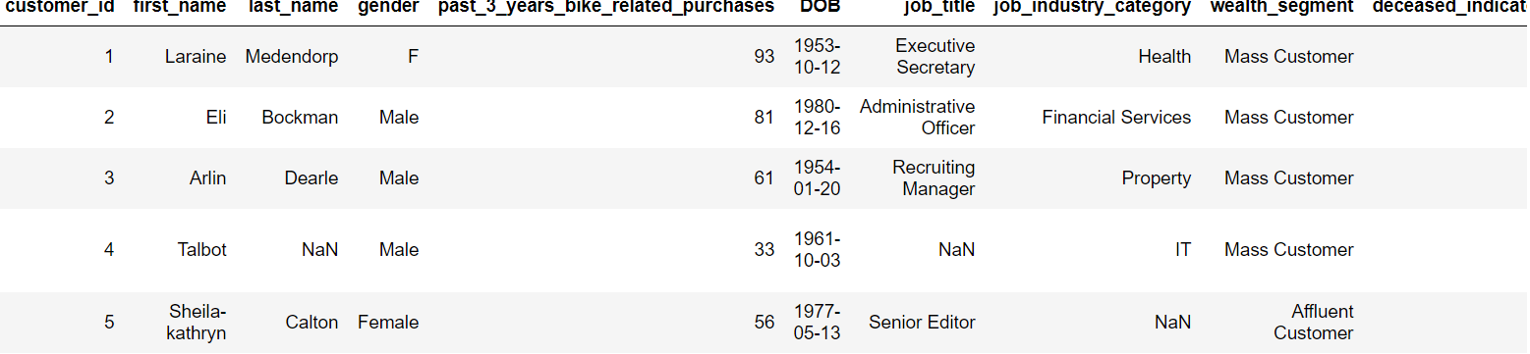
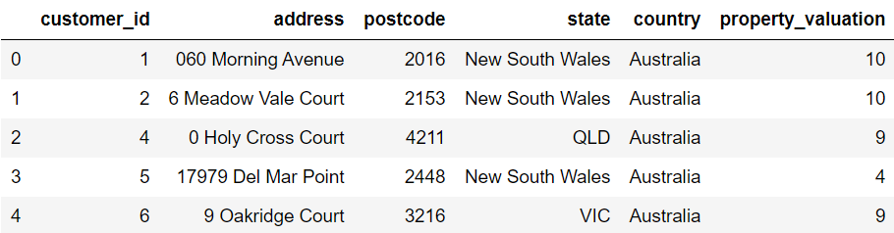
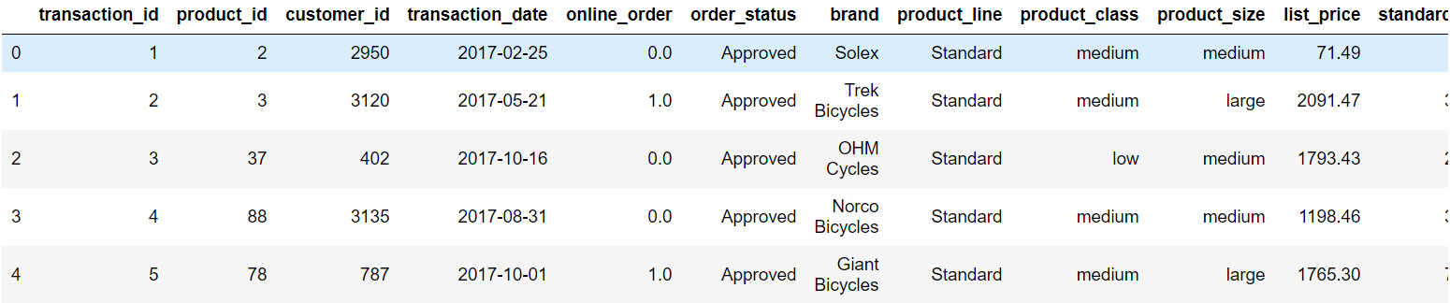
Note: The data and information in this document is reflective of a hypothetical situation and client. This document is to be used for KPMG Virtual Internship purposes only.
Data Exploration
3 Datasets of old customers and 1 dataset of potential customers.
Old customers datasets
1. Transactions Table 2. Address Table
3. Demographic Table

Slide 5
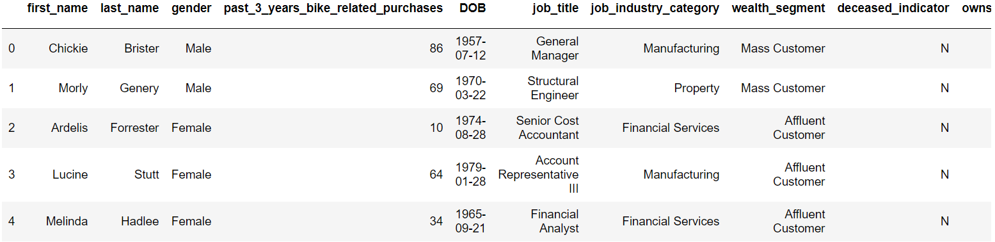
Note: The data and information in this document is reflective of a hypothetical situation and client. This document is to be used for KPMG Virtual Internship purposes only.
Data Exploration
3 Datasets of old customers and 1 dataset of potential customers.
New Customer List

Slide 6
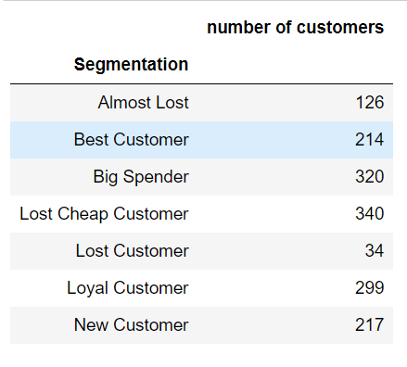
Note: The data and information in this document is reflective of a hypothetical situation and client. This document is to be used for KPMG Virtual Internship purposes only.
Model Development
Use RFM Model to evaluate customer value and segment customers.
R: Recency
F: Frequency
M: Monetary

Slide 7
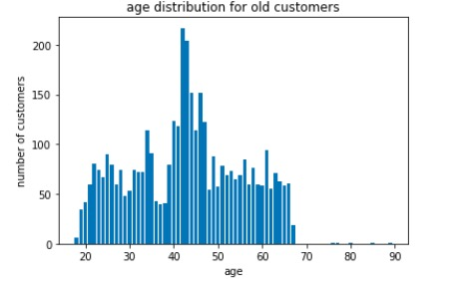
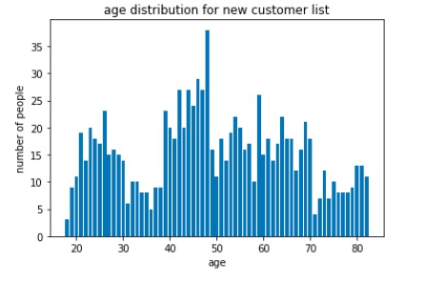
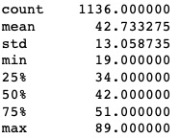
Note: The data and information in this document is reflective of a hypothetical situation and client. This document is to be used for KPMG Virtual Internship purposes only.
Model Development
Age distribution
Mean of Best Customers’ age
As we can see, middle aged customers have greater intention on buying bike.

Slide 8
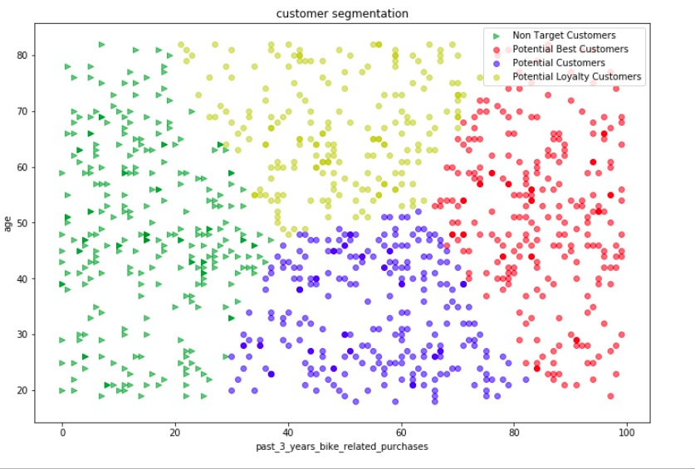
Note: The data and information in this document is reflective of a hypothetical situation and client. This document is to be used for KPMG Virtual Internship purposes only.
Model Development
K-Means Algorithm.
Segment by two features: age and past 3 years bike related purchase
1. Age: As we analyzed, different age groups have different preference on buying bike.
2. Past 3 years bike related purchase: For new customer list, there’s no transaction records, so we focus on related purchase
We want to find potential customers having highest value. Higher value means higher purchase power, so we don’t focus on personal information

Slide 9
Note: The data and information in this document is reflective of a hypothetical situation and client. This document is to be used for KPMG Virtual Internship purposes only.
Marketing Strategy
People with higher related purchase and age around 42 have higher potential values. Therefore, our resource of marketing campaigns should lean to people with these attributes
.
Product: Standard products are the most popular product line
Price: Apply some discount for family purchase
Place : Family Cycling events&Bike Amateurs Club
Promotion: Design some advertisements for families & bike amateurs

Slide 10
Note: The data and information in this document is reflective of a hypothetical situation and client. This document is to be used for KPMG Virtual Internship purposes only.
Thanks For Watching !

